Slide 1


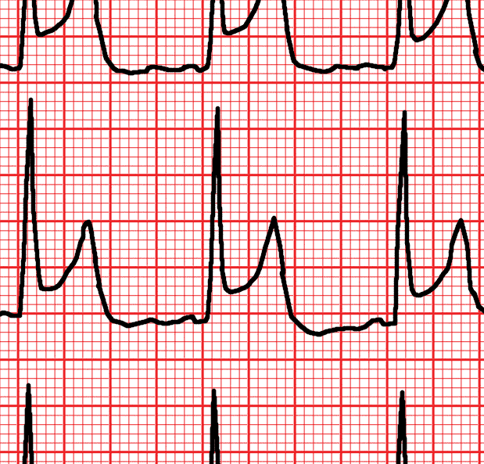
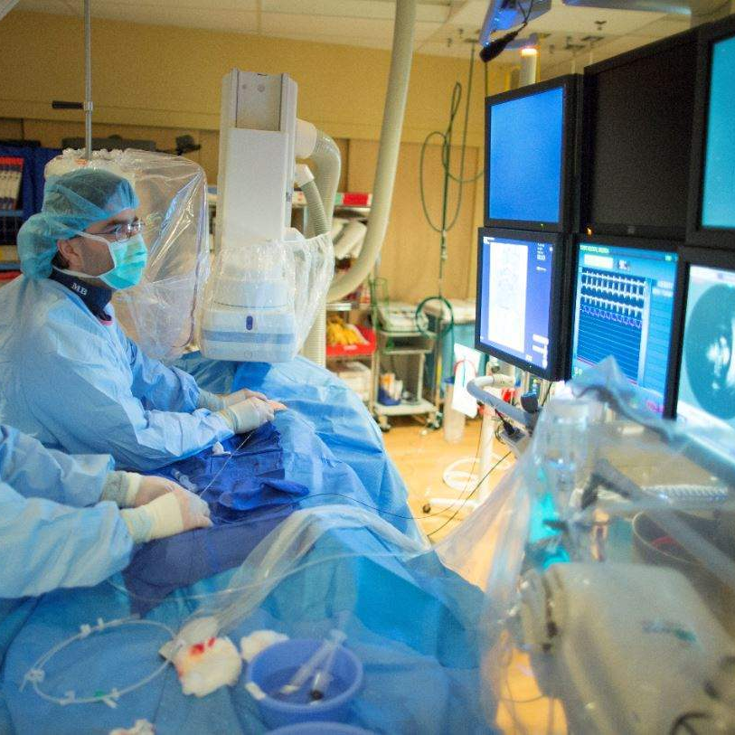

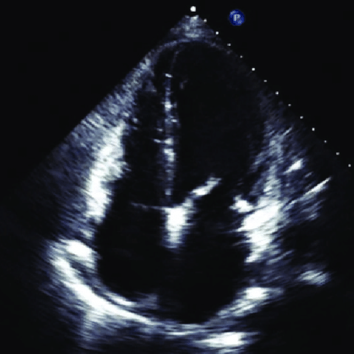


codefinder: optimising Stata for the analysis of large, routinely collected healthcare datasets
Jonny Batty
Wellcome Trust Clinical PhD Fellow
Leeds Institute for Data Analytics &
Leeds Institute of Cardiovascular and Metabolic Medicine
Notes:
Routinely collected healthcare data (including electronic healthcare records and administrative data) are increasingly available at the whole-population scale, and may span decades of data collection. These data may be analysed as part of clinical, pharmacoepidemiologic aprocedure codes using a number of discordant systems (including ICD-9 and 10, SNOMED-CT, Read codes, etc.) and the inherently relational nature of the data (each patient has multiple clinical contacts, during which multiple codes may be recorded). Pre-processing and analysing these data using optimised methods has a number of benefits, including minimisation of computational requirements, analytic time, carbon footprint and cost.
We will focus on one of the main issues faced by the healthcare data analyst: how to most efficiently collapse multiple, disparate diagnosis codes (stored as strings across a number of variables) into a discrete disease entity, using a pre-defined code list. A number of approaches (including the use of Boolean logic, the inlist function, string functions and regular expressions) will be sequentially benchmarked in a large, real-world healthcare dataset (n = 192 million hospitalisation episodes during a 12-year period; approximately 1 terabyte of data). The time and space complexity of each approach (in addition to its carbon footprint), will be reported. The most efficient strategy has been implemented into our newly-developed Stata command: codefinder, which will be discussed.
nd health services research, producing insights that improve future clinical care. However, the analysis of healthcare data on this scale presents a number of unique challenges. These include the storage of diagnosis, medication and

Slide 2









Introduction
Routinely collected healthcare data increasingly available at ‘whole-population’ scale.
Valuable – public health, clinical and pharmacoepidemiology, pragmatic clinical trials, etc.
Reflective of ‘real-world’ people and practice
Can be linked to other datasets
Reduces costs of undertaking research
Large numbers increase
power for discovery
A record of health across a person’s life
Integration of different types of clinical data
Derived tools can be integrated in EHR systems
Causal methods enable identification of cause and effect

Slide 3







Introduction
Vast quantities of data, encoded using many clinical coding systems:
  In UK: SNOMED-CT, Read/CTV-3, ICD-10, OPCS-4, vendor-specific coding systems, others...
  In US: ICD-10-CM, ICD-10-PCS, CPT, others...
With great power comes great responsibility
  Increasingly, sensitive data must be accessed remotely via Trusted Research Environments (TREs)
  Virtual machines: pre-installed software and packages (Stata, Python, R)
  Finite computational resources: limited CPU core counts, limited RAM, networking disabled
  Limited in/egress of code and data (including packages; often undergo manual checking)
Firewall
Firewall
Import:
packages, code
TRE
Pseudonymised data
‘Airlock’
Researcher
(e.g. me)
Identifiable data collected during
clinical care
Aggregation of data and removal of identifiers
Export:
analysis results
Compliant with ISO27001 / NHS DS&PT

Slide 4
The Problem
Key variables must be mapped using pre-defined codelists (10¹ – 10³ long):
  In/exclusion criteria, exposures, covariates and outcomes
Some codes may occur very infrequently or may not appear in a dataset at all.
Different data formats:
  Wide: multiple clinical codes per row (e.g. a single hospital admission) – not all will be populated
  Long: each code on a new row, with a timestamp or diagnosis number indicator
The datasets are very large: 10⁶ – 10⁹ observations; hundreds of gigabytes to tens of terabytes.
‘First principles’ approaches → cumbersome and inefficient code, with no ‘separation of concerns’.
ID | Episode | DX1 | DX2 | DX3 | DX4 | DX5 | DX6 | DX7
546534 | 00001 | I21.4 | I10 | K21.9 | E11.65 | J44.9 | M16.9 | F17
546534 | 00002 | I50.1 | I25.2 | I10 | F17 | . | . | .
ID | Episode | MI | HTN | DM
546534 | 00001 | 1 | 1 | 1
546534 | 00002 | 0 | 1 | 0
→
ID | Episode | DX | DX_num
546534 | 00001 | I21.4 | 1
546534 | 00001 | I10 | 2
546534 | 00001 | K21.9 | 3
ID | Episode | MI | HTN | DM
546534 | 00001 | 1 | 1 | 1
546534 | 00002 | 0 | 1 | 0
→

Slide 5
The “Ideal” Solution
The ideal solution to this problem will:
  ① Be simple to use
  ② Have optimal (average-case) time and space complexity: ideally O(n) or better
  ③ Maximise use of available computational resources
  Achieve separation of codelists from analytic code
  Have minimal (ideally zero) dependencies / plugins
Previous relevant work:
Canner J, Optimizing Stata for Analysis of Large Data Sets, Stata Conference (New Orleans), 2013.
Vega G, Parallel – Stata module for parallel computing. Stata Conference (New Orleans), 2013.
Guimaraes P, Big Data in Stata. Stata UGM (Portugal), 2015.
Cáceres Bravo MM, How to work efficiently with large datasets in Stata. BPLIM Workshop (Portugal), 2022.
NBER. Stata for very large datasets, 2019.
Strategy:
Benchmark different approaches, integrate most performant into a standalone package.

Slide 6





The Benchmark (I)
Dataset:
US HCUP Nationwide Readmission Database (NRD)
Wide-format hospitalisation data, 2010 – 2021
Up to 40 diagnosis codes per admission
192.2 million (x10⁶) inpatient episodes (observations), containing 2.2 billion (x10⁹) diagnosis codes.
ICD-9-CM and ICD-10-CM codes stored as str7
Diagnosis codes only: ~70 GB of RAM when loaded
Mapping of code strings to 5 variables:
KEY_NRD | DX1 | DX2 | DX3 | DX4 | … | DX40
201874894816 | O98812 | L7622 | Z3A25 | Q512 | … | Z8249
201874894817 | D62 | K922 | Z7901 | Z6834 | … | .
201874894818 | I214 | R570 | Z7951 | J9601 | … | .
201874894819 | I82B13 | B1710 | M542 | I878 | … | .
201874894820 | I639 | I10 | I2510 | Z2821 | … | .
201874894821 | S066X9D | S0219XD | I82411 | R1310 | … | G40909
201874894822 | M1611 | E785 | . | . | … | .
201874894823 | A419 | I10 | N12 | E860 | … | .
Acute MI
(73 codes)
Diabetes
(572 codes)
Hypertension
(136 codes)
Dyslipidaemia
(15 codes)
Obesity
(69 codes)
Total =
865 codes

Slide 7
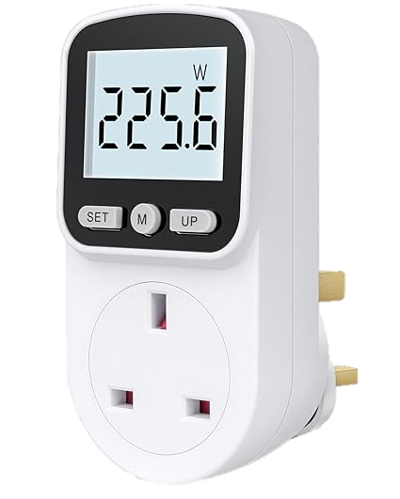




The Benchmark (II)
Measurements
Wall clock time to completion Stata timer
Peak RAM usage Windows Performance Monitor
Electricity usage Power Monitor plug (Mecheer) →
Analytic environment:
Stata 18 MP 64-core, Windows 11
AMD Ryzen 9 5950X 16-core CPU (3.4 → 4.9 GHz)
128 GB DDR4 3600 MHz RAM (4 x 32 GB)
Data stored on 2 TB NVME SSD
(TRE specs: often 4 core, 16/32 GB RAM, < 1TB HDD)
Benchmark starts ‘cold’: new Stata instance, no data.
Minimal other processes running.
All results validated.
Current UK energy cap:
£0.2236 / kWh
(until 30 Sep 2024)
Source: Ofgem
2023 UK CO₂ production:
225 g CO₂eq / kWh
(39% renewable)
Source: UK Government
← 1 kWh →
1 cycle
30 mins
12 hours
5 miles

Slide 8


The ‘Cup of Tea’ challenge
To map these codes...
... in less time than it takes to make and drink a cup of tea.
(15 – 20 minutes)
... using less electricity than it takes to boil the kettle to make a single cup of tea.
(3 kW electric kettle, ~1.5 minutes to boil = 0.065 kWh)

Slide 9
Approach 1: naïve, nested for-loops
Description of approach:
Loop over each variable. Within each loop, loop over each code to be identified. Perform pairwise comparisons.
Code excerpt:
1 | local ami_codes “I210 I211 I212 I213 I214 ...”
2 | gen ami = 0
3 | foreach dx of varlist DX* {
4 | foreach code in `ami_codes’ {
5 | replace ami = 1 if `dx’ == “`code’”
6 | }
7 | }
Results
Time: 103h : 10m : 59s 😥
Peak RAM: 72 GB
Energy: 18.4 kWh
Energy cost: £4.11
CO₂: 4.14 kg CO₂eq
Pros: Understandable for beginners, quick to write code, low space complexity
Cons: Very high time complexity, difficult to update and maintain code
Modifications: Replace nested loop with or (|) operators → 40h 44m (↓ 61%)
Replace nested loop with inlist(DX`var’, code1,...) functions → 31h 00m (↓ 70%)

Slide 10
Approach 2: reshape to long
Description of approach:
Reshape columns DX1 to DX40 into a single DX column. This is then searched using the inlist() approach.
Code excerpt:
1 | // Reshape to long (→ single column to map) and drop if missing
2 | reshape long DX, i(KEY_NRD) j(diagnosis)
4 | drop if missing(DX)
5 | // Perform code matching
6 | gen _ami = 0
6 | replace _ami = 1 if inlist(DX, “I210”, “I211”, “I212”,...)
7 | // Reduce back to one row per hospital admission
8 | egen ami = max(_ami), by(KEY_NRD)
9 | bysort KEY_NRD: keep if _n == 1
Results
Time: 12h : 54m : 22s 😐
Peak RAM: 121 GB
Energy: 2.2 kWh
Energy cost: £0.49
CO₂: 0.50 kg CO₂eq
Pros: Quick to write code, lower time complexity
Cons: Vastly higher space complexity (memory / disk), still difficult to update/maintain code
Modifications: Use a user-written reshape command:
fastreshape (11h 10m ↓ 13%), greshape (9h 1m ↓ 30%), tolong (8h 50m ↓ 32%), sreshape (7h 40m ↓ 41%)

Slide 11
Associative Arrays in Mata
asarray() = associative array = dictionary = hash table = map.
An array in which the indices are not necessarily integers – most commonly strings.
asarray[“key”] = value, e.g. price[“Orange juice”] = 1.25 price[“Apple juice”] = 1.00
Two very useful properties for mapping codes:
① Very fast retrieval (~ instantaneous if number of keys < 10⁷)
② Can set behaviour if key does not exist (notfound), e.g. return a null string (“”).
Brief review of syntax:
A = asarray_create() declare A
asarray(A, key, a) A[key] = a
a = asarray(A, key) a = A[key] or a = notfound
asarray_remove(A, key) delete A[key] if it exists
asarray_notfound(A, notfound) set notfound value
*class-based interface also available

Slide 12

Using asarray() to map codes
Simplified process:
Text files containing lists of codes (one per line)
① Mata function reads and parses text files containing code definitions into a colvector.
File prefix used as variable name: no spaces permitted.
ami.txt
htn.txt
dm.txt
dys.txt
obs.txt
② A single, ‘master’ lookup associative array is declared (A). A stores the variable(s) to be mapped from a given code. This returns a null string (“”) if a key is not found.
colvectors of each codelist
A = asarray_create()
asarray_notfound(A, "")
for (i = 1; i <= rows(colvector); i++) {
asarray(A, colvector[i], varname)
}
{
“A123”: “htn”,
“B456”: “ami”,
“C789”: “dys”,
“D321”: [“htn”, “dm”],
“E654”: “obs”
}
DX1
DX2
DX3
ami
htn
dm
dys
obs
0
0
1
1
1
1
1
0
1
1
0
0
0
0
0
③ A view of all nonmissing codes to be mapped is created. Each code is used to query the associative array.
0
1
0
0
0
0
1
0
1
0
0
0
0
0
0
1
1
1
1
1
0
1
0
1
0
0
0
1
0
1
0
1
1
0
1
A: master lookup associative array
Iterate over nonmissing codes, querying A
‘Hits’ replace corresponding Stata variable(s) = 1
④ ‘Hits’ from the query trigger the corresponding variable to be replaced with 1.

Slide 13
Approach 3: associative arrays
Description of approach:
Load all codelists into an associative array (keys = codes, values = variable name); packaged in codefinder
Code excerpt:
1 | clear all
2 | // Specify paths to data and codelist files
3 | local data "..\data\dataset.dta"
4 | local code_files MI.txt HTN.txt DM.txt OBS.txt DYS.txt
5 | // Run codefinder
6 | codefinder DX*, dataset("`data’") ///
7 | codefiles("`code_files’") ///
8 | id(KEY_NRD)
Results
Time: 1h : 10m : 8s 🙂
Peak RAM: 75 GB
Energy: 0.20 kWh
Energy cost: £0.04
CO₂: 45 g CO₂eq
Pros: Quick to write code, lower time complexity, reasonable space complexity, easy to update / maintain code,
no dependencies or plugins (no compiled code).
Cons: Could still be quicker (→ this is an ‘embarrassingly parallel’ problem)

Slide 14
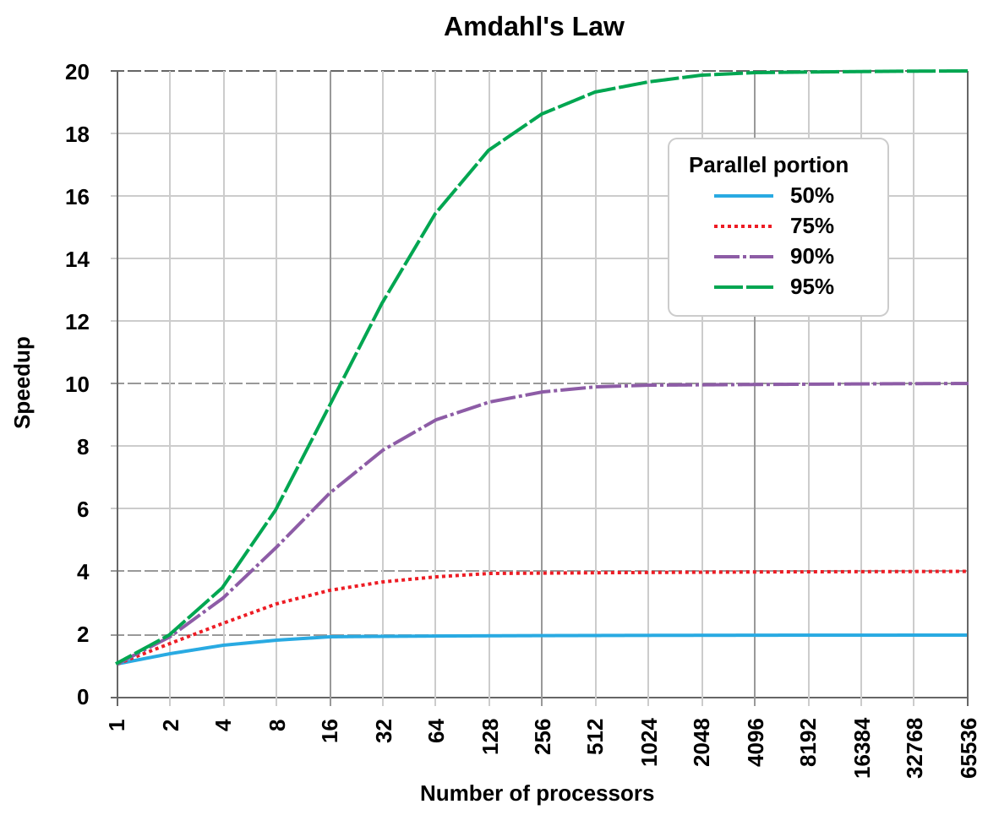
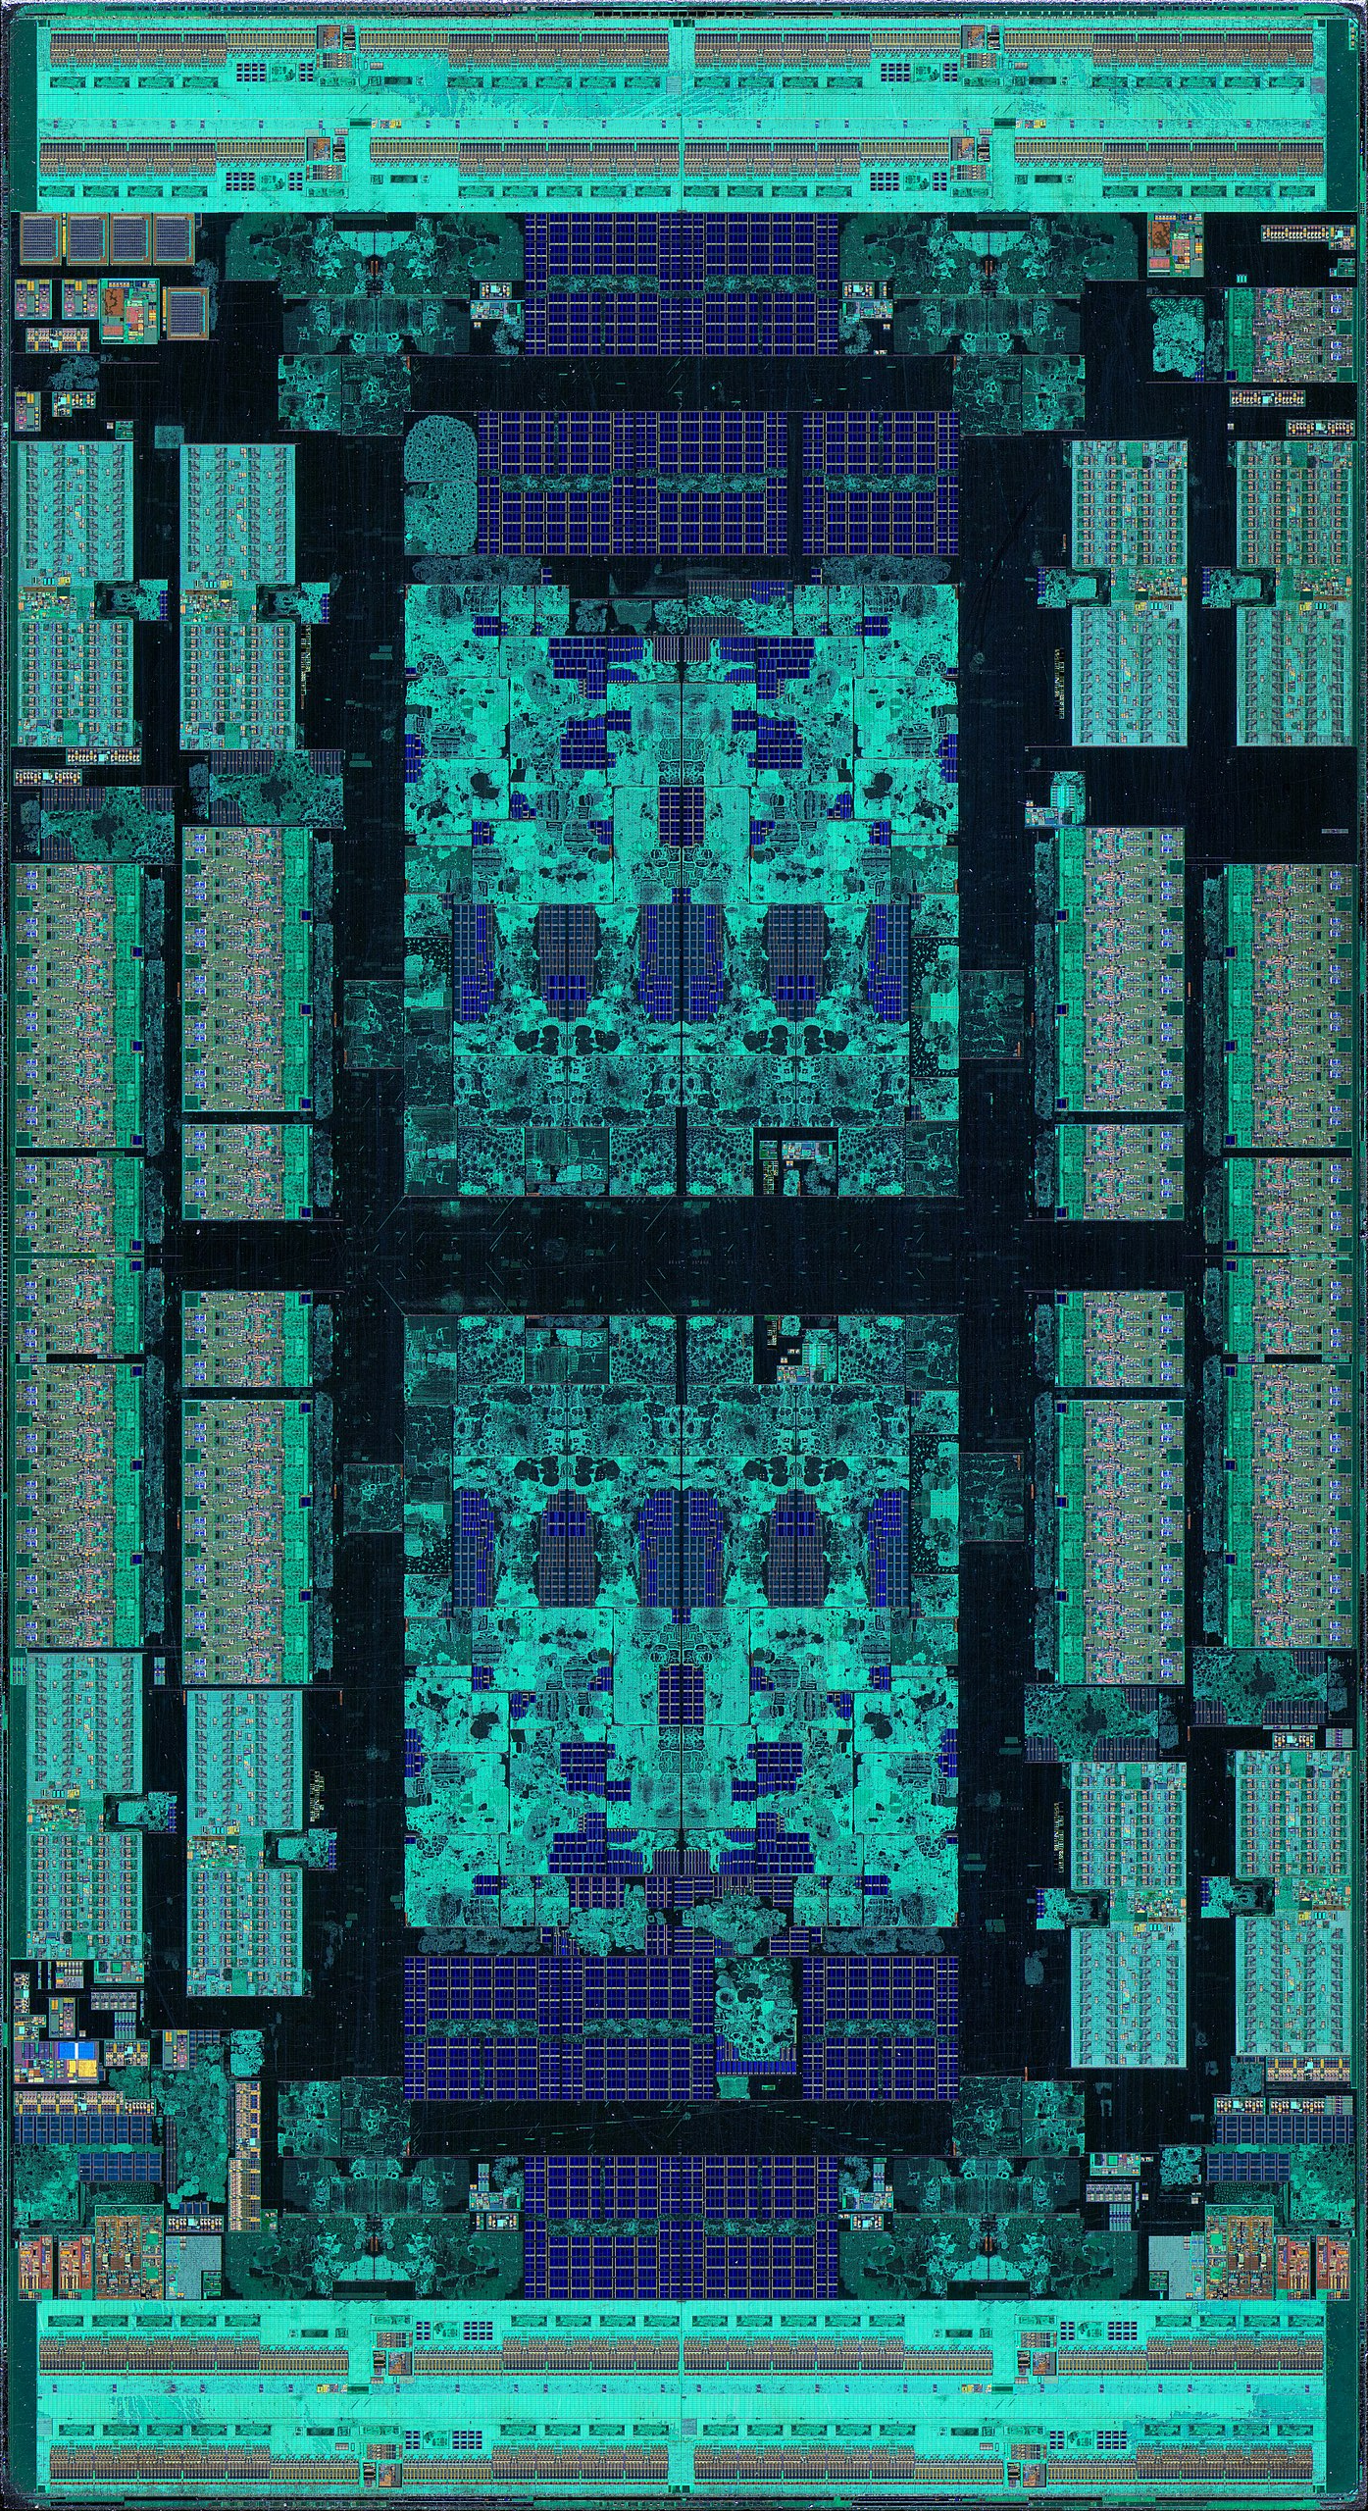
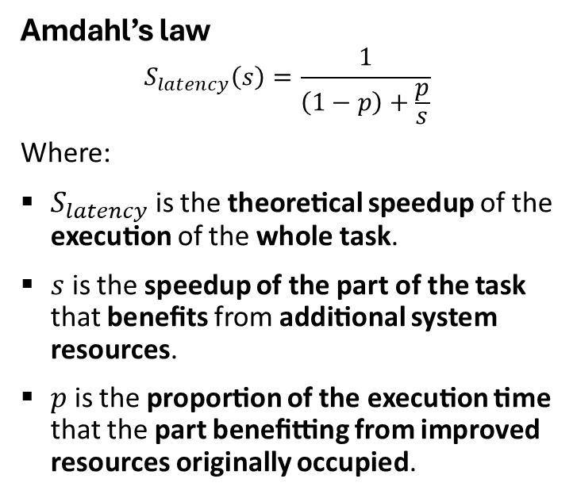
Parallel processing
Modern CPUs have complex architectures with multiple (physical) cores.
However, not all code can be perfectly parallelised: i.e. using 10 vs 1 core(s) will not (necessarily) result in a 10x speedup.
Amdahl’s law
$$S_{latency}\left(s\right)=\frac{1}{\left(1−p\right)+\frac{p}{s}}$$
Where:
$S_{latency}$ is the theoretical speedup of the execution of the whole task.
$s$ is the speedup of the part of the task that benefits from additional system resources.
$p$ is the proportion of the execution time that the part benefitting from improved resources originally occupied.
AMD EPYC 7702 64-core CPU
Source: Wikimedia commons

Slide 15

Approach 4: add parallelisation
Description of approach:
As in (3) – associative arrays – but loading/mapping of ‘chunks’ of data occurs in parallel (across 16 CPU cores).
Code excerpt :
1 | clear all
2 | // Specify paths to data and codelist files
3 | local data "..\data\dataset.dta"
4 | local code_files MI.txt HTN.txt DM.txt OBS.txt DYS.txt
5 | // Run codefinder
6 | codefinder DX*, dataset("`data’") ///
7 | codefiles("`code_files’") ///
8 | id(KEY_NRD) ///
9 | n_cores(16)
Results
Time: 0 h : 10 m : 2 s 😀
Peak RAM: 74 GB
Energy: 0.038 kWh
Energy cost: < £0.01
CO₂: 8.6 g CO₂eq
Pros: Quick to write code, lower time complexity, reasonable space complexity, easy to update/maintain code, no dependencies or plugins (no compiled code).

Slide 16
codefinder
Installation: ssc install codefinder (coming soon – for now, see GitHub!)
Help file: help codefinder
Usage example: local data "..\data\dataset.dta"
local code_files MI.txt HTN.txt DM.txt OBS.txt DYS.txt
codefinder DX*, dataset("`data’") ///
codefiles("`code_files’") ///
id(unique_id) ///
n_cores(16)
Calculation based on Amdahl’s law (~7x speedup with 16 cores vs. 1 core) = 91.4% parallelised.
The greater the complexity of the code mapping problem (i.e. number of observations, variables containing codes, codes to be searched) the greater the benefits of parallelisation (using additional cores).
More at: https://github.com/jonathanbatty/stata-codefinder

Slide 17
Conclusions and Future Work
Summary:
codefinder uses Mata, associative arrays and parallel processing to efficiently map clinical codes.
‘Separation of concerns’ key to a maintainable, extensible and reproducible codebase.
Vastly lowers ‘activation energy’ required to start analysis
Further optimisations:
Additional vectorisation (without major ↑ space complexity; “naïve” vectorisation → 15.2 TB of RAM)
Address main serial bottleneck: time to load data from SSD into RAM
Better RAM (DDR5, up to 6400 MT/s), better SSD (PCIe 5.0 M.2 standard; more PCIe lanes), “RAM disk”

Slide 18
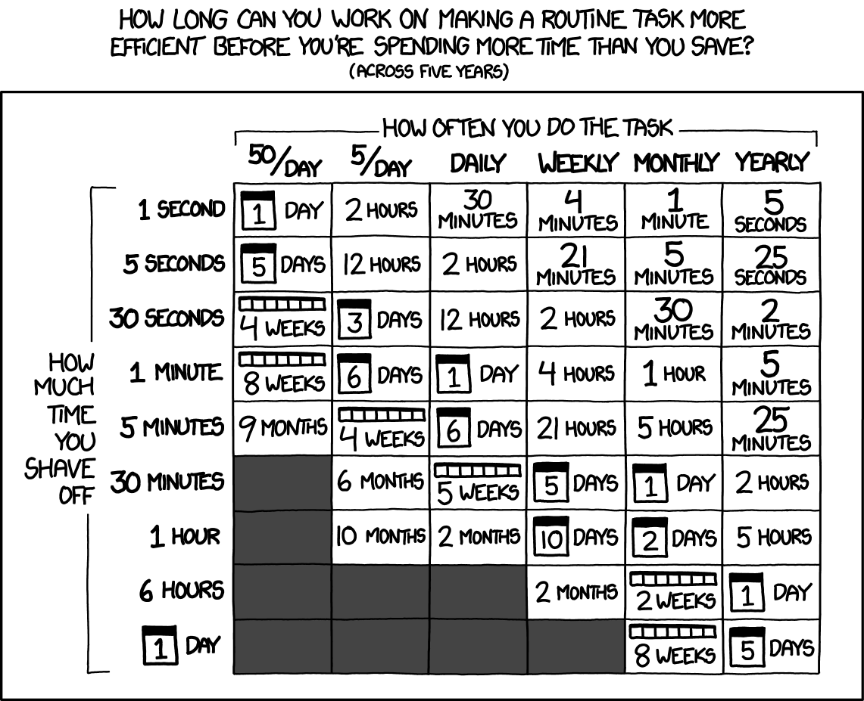
Final thoughts...
Munroe R. XKCD: Is it worth the time?
https://xkcd.com/1205/

Slide 19









Acknowledgements
Dr Marlous Hall
Associate Professor of Epidemiology
Dr Christopher Hayward
Health Data Scientist
Dr Charlotte Sturley
Spatial Epidemiologist
Dr Evrim Anik
Research secondment in Health Data Science
Tamara Del Toro
BHF PhD Fellow
Eleanor Booth
NIHR Research Fellow in Epidemiology

