Slide 1
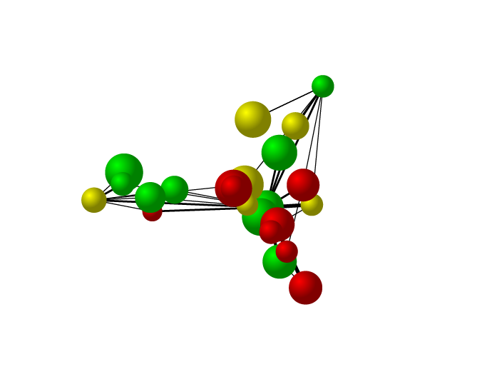

Plotting and Analyzing Networks in Stata
27 Sept 2013, Stockholm
Nordic and Baltic Stata Group Meeting
Thomas Grund
Institute for Futures Studies
thomas.grund@iffs.se
powered by
(with contributions from Peter Hedström, Yvonne Aberg, Lorien Jasny)

Slide 2
Why Network aNalysis with Stata?
Given the availability of specialized software programs for social network analyses such as Ucinet, Pajek or packages in R, why do we believe that Stata is a useful environment for such analyses?
Introduction of Mata makes network analysis easier and feasible. Much richer set of tools for describing and analyzing the results of the analyses than most dedicated programs for social network analysis (except R).
Reduces learning and re-tooling costs. Transition will be smoother for those who already use Stata. Many social scientists know Stata.
Nice graph engine available.

Slide 3



Social Networks
$$N=G\left(V,E\right)$$
$$V=\left\{v_{1},v_{2},v_{3},v_{4}…v_{N}\right\}$$
$$E=\left\{\left(v_{1},v_{2}\right), …v_{N}\right\}$$
directed/undirected tie
weighted/unweighted tie
simple/multiple ties
symmetric network
multiplex network
one-mode/two-mode network
see e.g. Wasserman & Faust (2001)

Slide 4
Adjacency Matrix
A convenient representation of graphs and digraphs (we often just say “graphs" when we also refer to digraphs) is the adjacency matrix:
j is adjacent to i if there is a tie from i to j;
the adjacency matrix is the matrix (y_{ij} ) with
The diagonal of the adjacency matrix will be structurally zero
when there are no self-ties.
, if there is a tie from i to j
, if there is no tie from i to j

Slide 5
Storing Networks
Note:
Directed vs. undirected paths.
Weighted vs. unweighted paths.
Network change as changes in the cells of the adjacency matrix.

Slide 6

nw-package

Slide 7
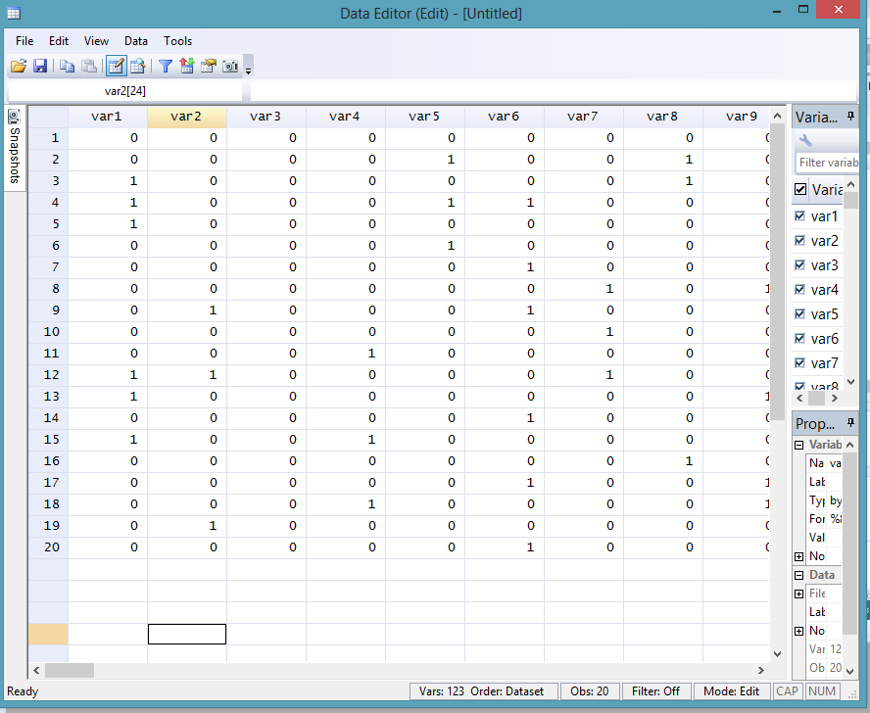

Slide 8
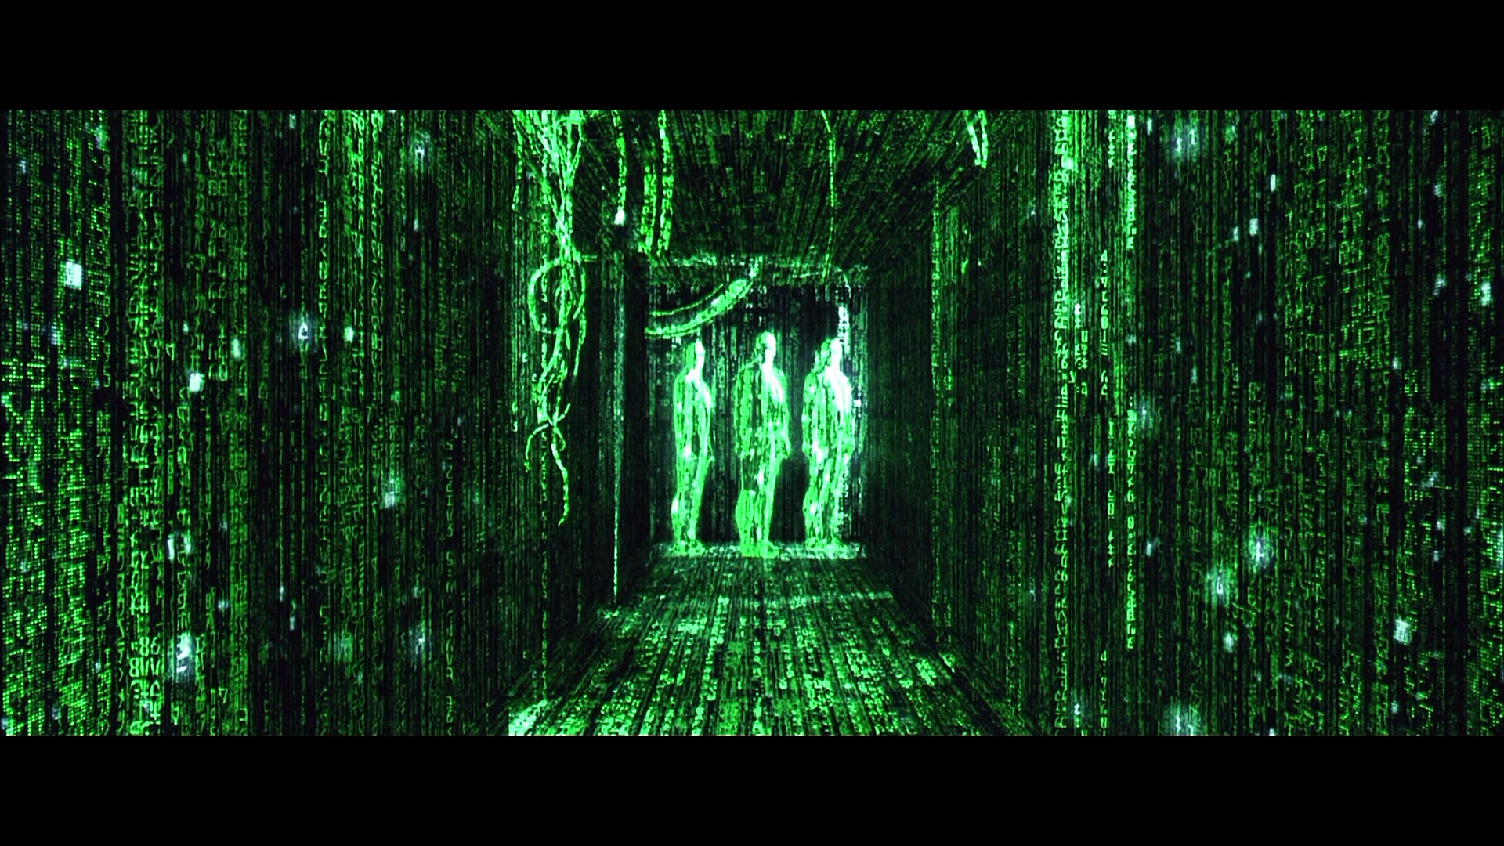
Generating Contexts

Slide 9
Nwcommands
nwimport: import either Ucinet, Pajek, matrix
nwrandom: create Erdos-Renyi network
nwlattice: create regular lattice
nwsmall: create small-world network
nwpref: create preferential attachment network
nwcommun: create community network

Slide 10
Random Network
MDS Layout
nwrandom 10, prob(0.8)
nwgraph
nwrandom 10, prob(0.3)
nwgraph

Slide 11
Lattice Network
MDS Layout
Lattice Layout
nwlattice, rows(5) cols(5)
nwgraph
nwlattice, rows(5) cols(5)
nwgraph, lattice

Slide 12
Small World Network
Circle Layout
nwsmall, neighb(4) shortc(5)
nwgraph, circle

Slide 13
Preferential attachment Network
nwpref 20, minout(2) maxout(2)
nwgraph, cricle
nwdegree
hist indegree, width(1) freq

Slide 14
Community Network
nwcommun 30, groups(3) gprob(0.4) prob(0.05)
nwgraph, cat(groupid)

Slide 15

Network Visualization

Slide 16
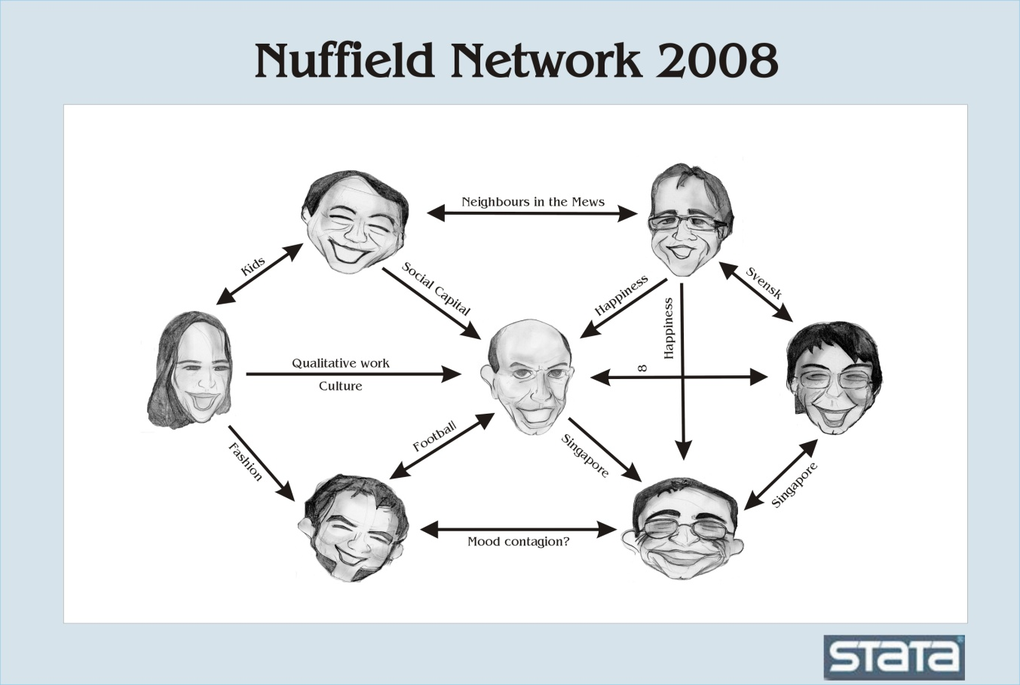

Slide 17
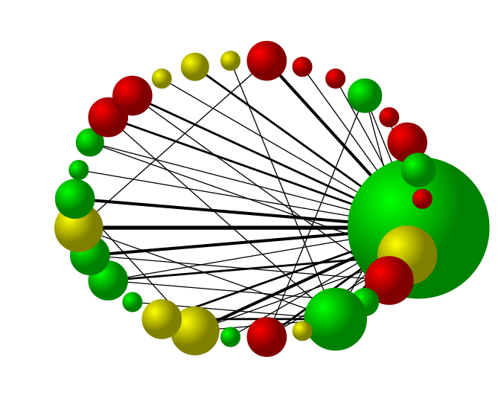
nwsvggraph
powered by

Slide 18
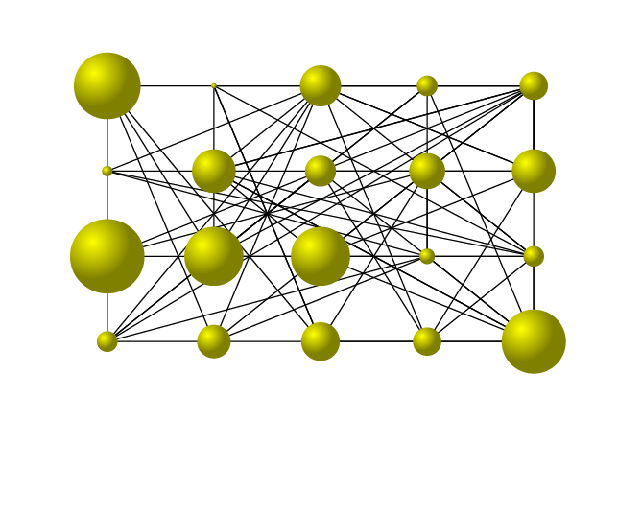
nwsvggraph
powered by

Slide 19
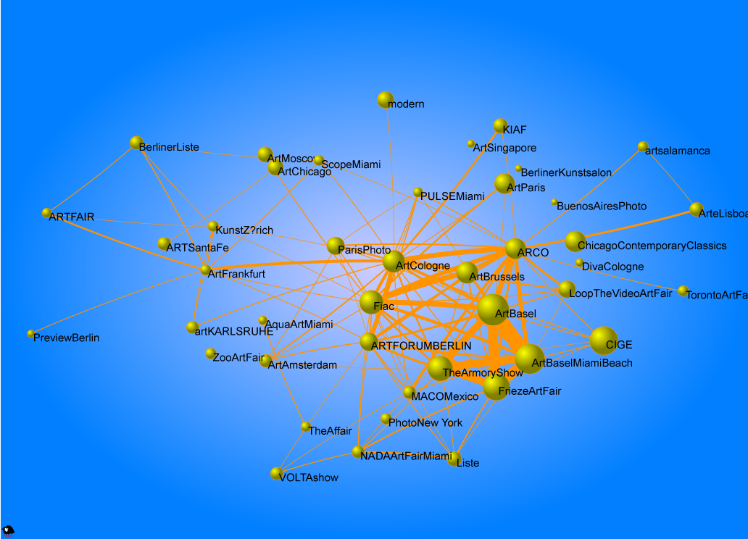
Network Dynamics
powered by

Slide 20
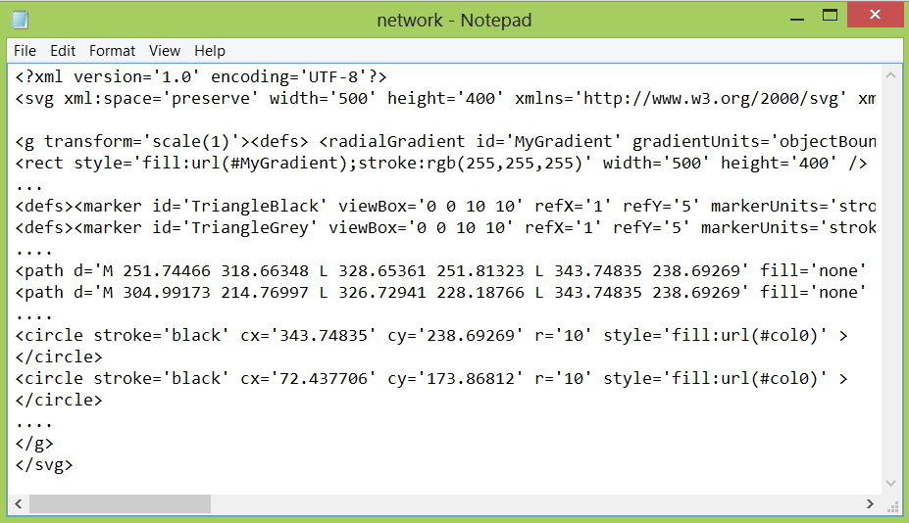
SVG – scalable vector Graphics (W3C)
nwsvggraph

Slide 21







Process Vector Graphics
shell network.svg

Slide 22
nwsvgGraph
Many options…
General: width(600) height(300) ystretch(.8) xstretch(.5)
Layout: mds, circle, lattice
Background: background1(255 0 255)
Label: labeltext(“my network”) labelsize(15)
Label: labelx(10) labely(20) labelcolor(yellow)
Nodes:
  nlabels(id)
  nfactor(3) ncolor(mycolors) nsize(mysizes)
Edges:
  arrowhead
  efactor(2)
…

Slide 23
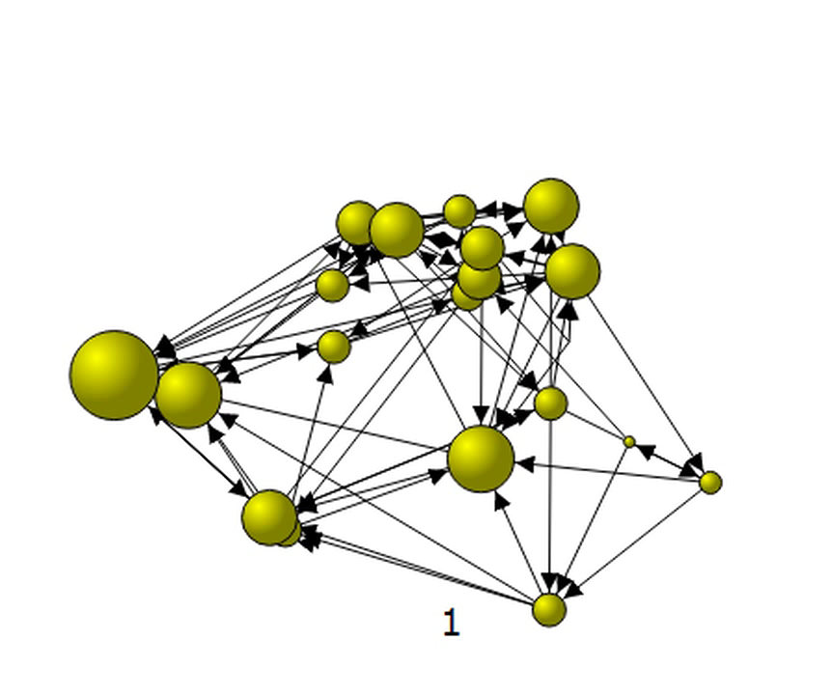
Nwsvggraph animation
nwsvggraph, nsize(size_time*)

Slide 24
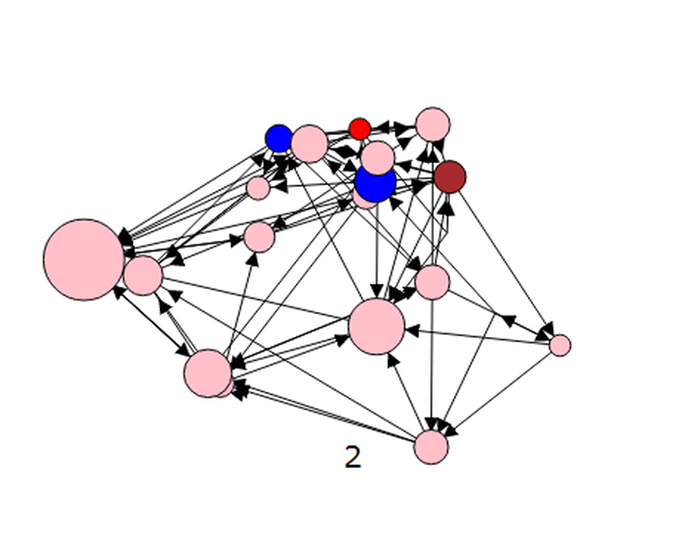
Nwsvggraph animation
nwsvggraph, nsize(size_time*) ncolor(col_time*)

Slide 25
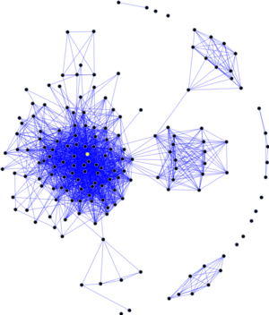
Network Analysis

Slide 26
Network Properties
Number of neighbours (degree)
How many ties do individuals have?
What is the average number of individuals that any individual in the network interacts with?
Of the individuals that I interact with, what fraction of those also interact with each
The friends of my friends are my friends
How many interactions does it take to get from one person in the network to any other person in the network?
What is the longest amount of time it takes to get from any one person in the network to any other person other?
Clustering
Shortest paths

Slide 27
Nwcommands
nwimport: imports network data
nwgraph: simple graph
nwsym: make network symmetric
nwtoedge, nwtoadj, nwfilledge: transform format
nwtomata, nwtostata: communicate with Mata
nwneighbor: get selection of network neighbors
nwcontext: retrieve attribute information from neighbors
nwdensity: density of the network
nwdegree: degree of nodes
nwcluster: local and global clustering
nwcloseness: local and global closeness
nwcomponents: connected components
nwgeodesic: shortest paths between nodes
….
A lot of these commands draw on our nwcommands.mlib library
Not available through Stata findit yet.

Slide 28
Simple Agent-Based Model
nwlattice, r(10) c(10)
nwsym, unweighted
nwdegree
gen threshold=uniform() * outdegree
gen act = int(uniform()+.1)
forvalues t=1/50 {
gen act_time`t' = act
nwcontext act, gen(pressure)
replace act = 1 if pressure >= threshold & act == 0
drop pressure
}

Slide 29

Outlook

Slide 30
Outlook ?
Basically, keep programming Ucinet functions in Stata…
Add functionality to nwsvggraph…
Add capabilities for network modeling:
  p1, p2 models…
  Permutation tests…
  Piggyback on existing libraries in R (ergm, RSiena)…
Make it all available as nw-package

