Slide 1

Stata in the measurement and analysis of poverty in Mexico
2009 Mexican Stata Users Group Meeting
April 2009, Mexico city

Slide 2
National Council of Evaluation of Social Development Policy (Coneval)
Creation of CONEVAL
General Law of Social Development (January 2004)
Object of the Law:
“To guarantee the total exercise of the social rights established in the Political Constitution of Mexico ”
Article 81: Establishes the creation of the Council
Income Poverty Measure in Mexico
(recent history)
In 2001 the Ministry of Social Development created the National Committee for Poverty Measure (CTMP).
  7 academics and
  4 government members: CONAPO, INEGI, Ministry of Social Development, and Presidencia)
In 2002 The Committee proposed a methodology:
http://www.sedesol.gob.mx/archivos/801588/file/Docu01.pdf
National Council of Evaluation of Social Development Policy
The Council is a public decentralized organism of the
federal public administration with technical
autonomy
The direction of the Council is given by:
  Six academic researchers and
  Executive secretary
Responsibilities:
1) Establish the criteria to define, identify, and measure poverty, and
2) Rule and coordinate the evaluation of the national policy of social development
Right now, CONEVAL is working on a new
methodology for multidimensional poverty measure

Slide 3
Stata and CONEVAL
Stata and the measurement of poverty
Why do we use Stata?
To use survey and census data and generate inputs, indicators, and other relevant information to measure, characterize, and analyze the phenomenon of poverty; and help in the decision making process to alleviate it.
Content of presentation:
1) Inputs in poverty measurement
2) Construct poverty indicators
3) Poverty analysis
4) Poverty mapping

Slide 4
Income poverty, 1992 -2006
National, urban and rural

Slide 5
1) Inputs in poverty measurement
Construction of food poverty line (example)
Adjustment coefficient:
AC = consumed calories/required calories
per household
Reference households stratum:
Used to construct an observed food
basket and determine the (food) poverty line
2006 Official (food) poverty line:
Urban: $809.87 (mxn pesos)
Rural: $598.70 (mxn pesos)

Slide 6
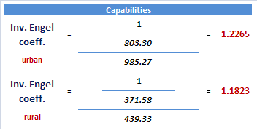
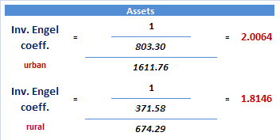

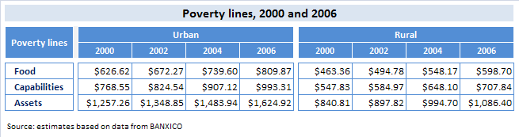
1) Inputs in poverty measurement
Non-food poverty lines: Inverse of Engel coefficient
Engel coefficient:
Ratio that measures the expenses on food in households
as a proportion of the expenses needed to cover:
- health and education: Capabilities line, and
- public transport, clothing, and housing: Assets line
The ratio is calculated for rural and urban areas in a
reference stratum

Slide 7
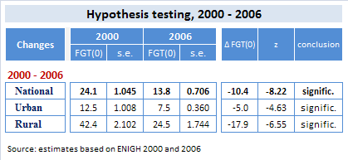
1) Inputs in poverty measurement
Standard errors and hypothesis testing
Standard errors:
# delimit ;
foreach x in 1992 1994 1996 1998 2000
2002 2004 2005 2006 { ;
use “$data\poverty `x’.dta”, clear ;
svyset upm [w=factorp], strata(est) vce(linearized) ;
svy linear, level(95): mean povlp1 ;
} ;
Hypothesis testing:

Slide 8

2) Poverty indicators
Poverty gap and squared poverty gap
FGT(α) :
Foster, J., J. Greer, and E. Thorbecke (1984), “A Class of Decomposable Poverty Measures”, Econometrica, vol. 52, pp. 761-765.
# delimit ;
gen fgt0 = cond(income<pov_line,1,0) ;
gen fgt1 = cond(fgt0==1,(pov_line - income)/pov_line,0) ;
gen fgt2 = cond(fgt0==1,((pov_line - income)/pov_line)^2,0) ;
tabstat fgt* [w=factorp], stats(mean) by(area) format(%6.4f) ;

Slide 9
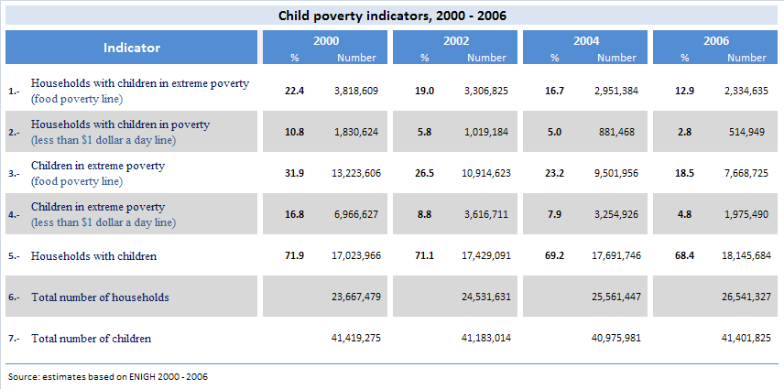
2) Poverty indicators
Child poverty indicators

Slide 10
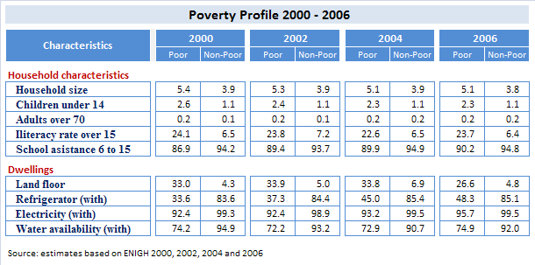
3) Poverty analysis
Poverty profile

Slide 11
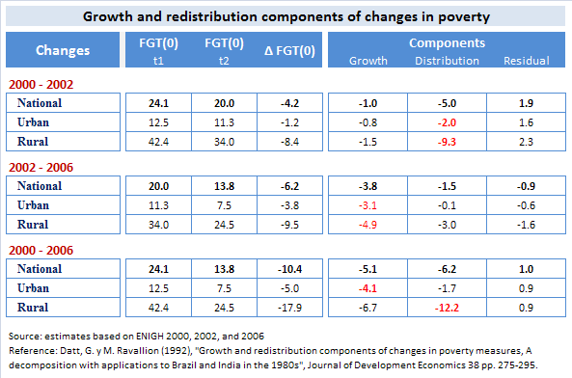
3) Poverty analysis
Components of changes in poverty measures

Slide 12
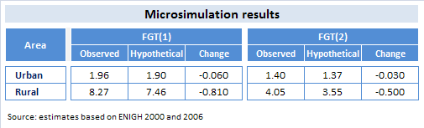
3) Poverty analysis
Microsimulation of an intervention (example)
Microsimulation :
Using the income and expenditure survey of 2006, the
microsimulation consists in increasing by $180 pesos
the households’ income of a public programme net

Slide 13
4) Poverty mapping
Stata and the income poverty maps
Poverty mapping
National level indicators often hide important differences between regions or areas. The analysis of poverty interventions consequently requires a focus on poverty information that is more geographically disaggregated.
Stata and poverty mapping
1) Social gap index
2) Estimate income poverty and a set of indicators from survey data
3) Generate the same set of indicators from census data (very hard work!)
4) Validate poverty measures with other indices
5) Compute changes in poverty

Slide 14
4) Poverty mapping
Social gap index 2005
Methodology
Components
Principal component analysis (PCA) using
Census data 2005
Variables defined in the General Law of Social
Development
Index stratification:
  Very low
  Low
  Medium
  High
  Very high
Disaggregation levels:
  Entities
  Municipalities
  Localities
1. Population over 15 years illiterate
2. Population between 6 and 14 that doesn’t attend to school.
3. Population over 15 years with incomplete basic education
4. Households with people between 15 and 29 years with at least one member with less than 9 years of education
5. Population without health security
6. Dwellings without washing machines
7. Dwellings without refrigerator
8. Dwellings with sand floor
9. Dwellings without toilets
10. Dwellings without tubed water of the public network
11. Dwellings without sewage
12. Dwelling without electric energy
13. Overcrowding

Slide 15
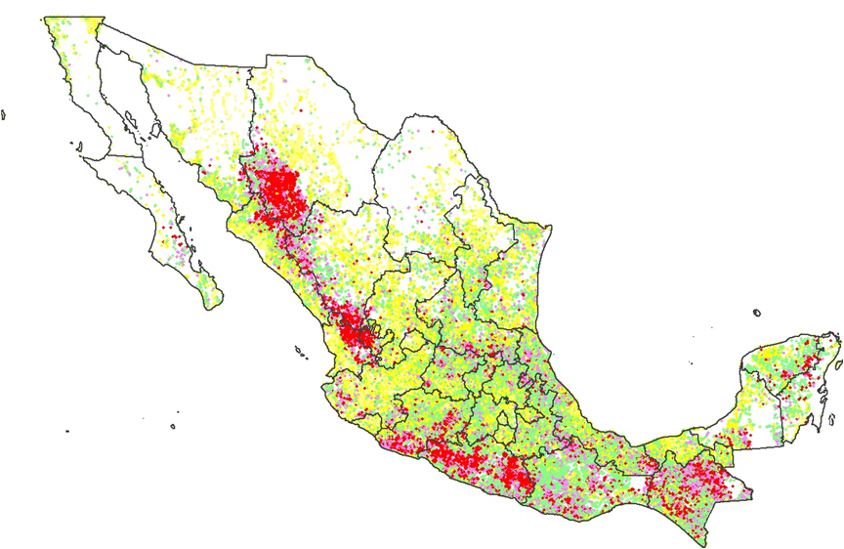
Social gap index
Localities, 2005
Social Gap Degree
Very low
Low
Medium
High
Very high

Slide 16
Poverty mapping
Income poverty and other indicators
Y = 2.13 – 2.39 X
adj. R² = .7177
Y = 0.33 + 0.17 X
adj. R² = .8032

Slide 17
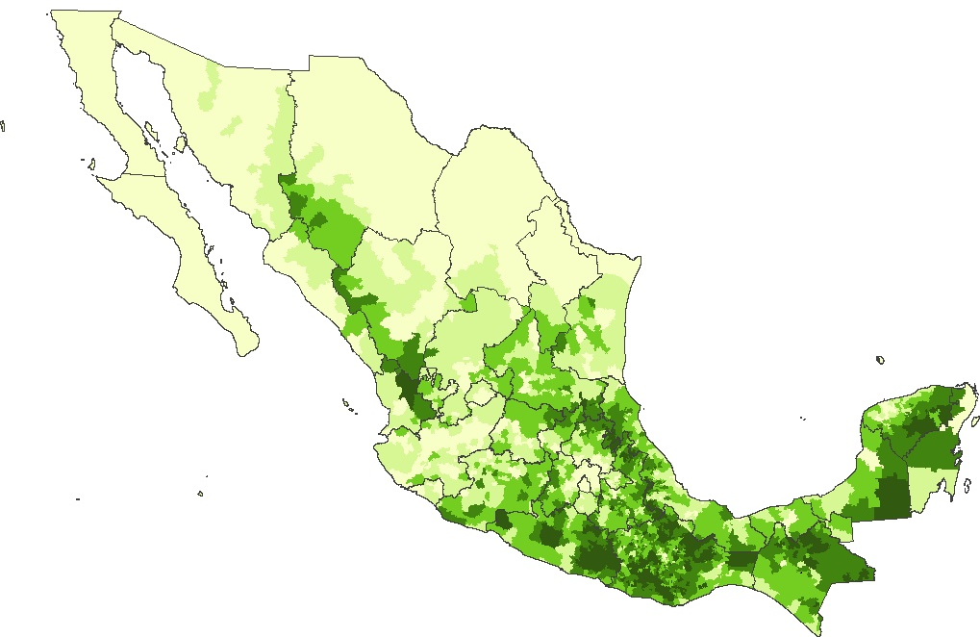
Food poverty map
Municipalities, 2000

Slide 18
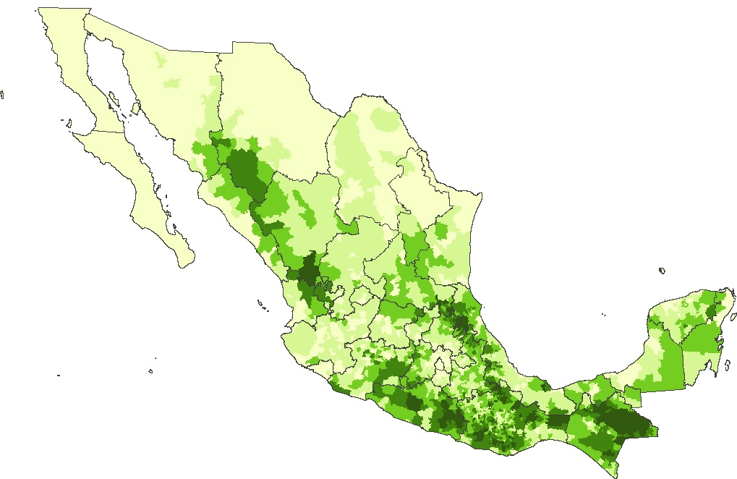
Food poverty map
Municipalities, 2005

Slide 19
Changes in income poverty
Municipalities, 2000 - 2005

Slide 20
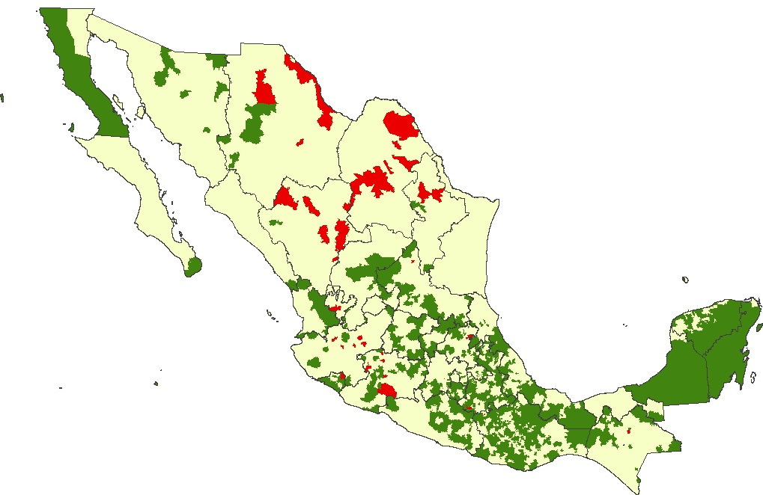
Changes in food poverty map
Municipalities, 2000 - 2005

Slide 21
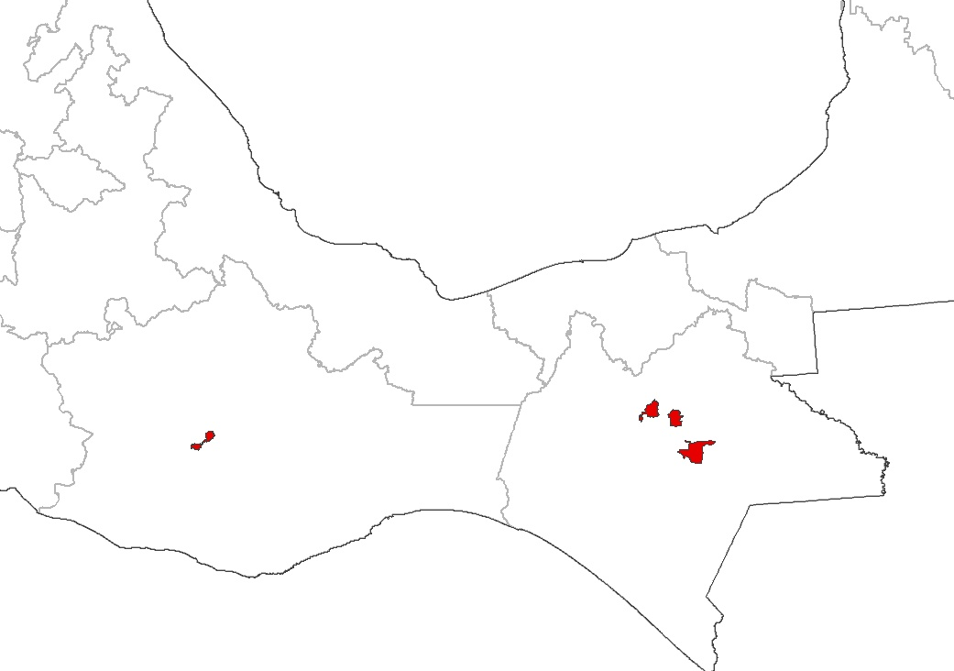
Income poverty and Social gap index
Five municipalities with highest poverty rates and very high social gap level
Chalchihuitán
Population: 13,295 Hab.
Food poverty: 81.4%
Social gap degree: Very high
San Pablo Cuatro Venados
Population: 1,267 Hab.
Food poverty: 81.1%
Social gap degree: Very high
San Juan Cancuc
Population: 24,906 Hab.
Food poverty: 83.7%
Social gap degree: Very high
Santiago el Pinar
Population: 2,854 Hab.
Food poverty: 84.0%
Social gap degree: Very high
Chanal
Population: 9,050 Hab.
Food poverty: 83.1%
Social gap degree: Very high

Slide 22
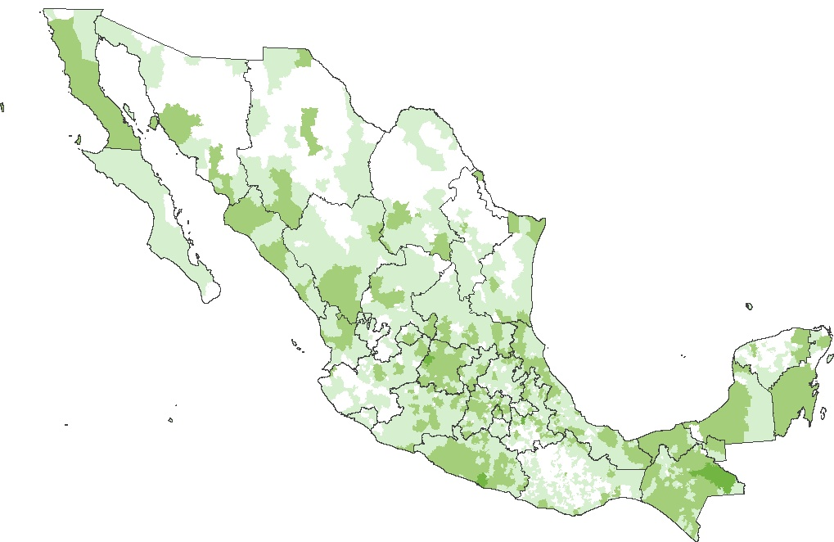
Food poverty map (number of population in poverty)
Municipalities, 2005

Slide 23
CONEVAL online
Please visit us at:
  www.coneval.gob.mx
Do files available at:
http://www.coneval.gob.mx/coneval2/htmls/medicion_pobreza/HomeMedicionPobreza.jsp?categorias=MED_POBREZA,MED_POBREZA-med_pob_ingre
Surveys available at:
  http://www.inegi.org.mx/est/contenidos/espanol/soc/sis/microdatos/enigh/default.aspx?s=est&c=14606
Authors:
Héctor H. Sandoval (hhsandoval@coneval.gob.mx)
Rodrigo Aranda Balcazar (ranohead@gmail.com)
Martín Lima (jlimav@gmail.com)

